Slide 1
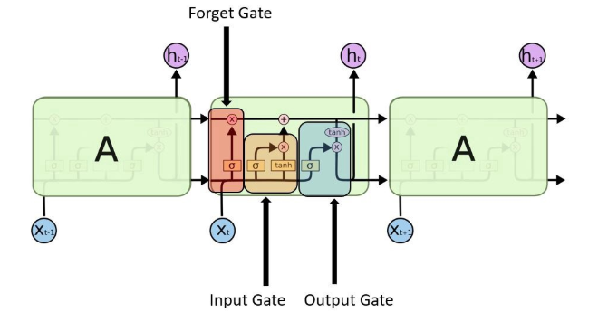
Possible Q
1. What if there is a new word in the test data?
Calculate the parameter number in LSTM
How to initialize the weights
How to decide epoch
IMDB with LSTM
Why not use ReLU in LSTM for vanishing gradient

